Slide 1

Generating music with LSTM
MSBA7011 Managing and Mining Big Data Audiophile

Slide 2
Our goal:
Pick one artist, and use his songs as training data
Generate new music using LSTM model.
The model should generate new music in the style of that artist

Slide 3
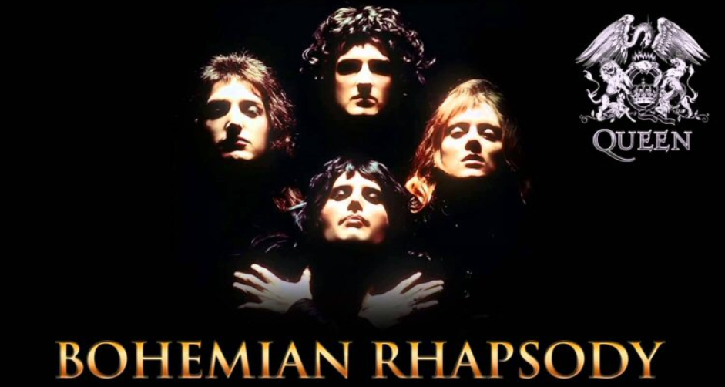
Queen
One of the most famous band in the world. Members: Freddie Mercury, Brian May, Roger Taylor, John Deacon

Slide 4

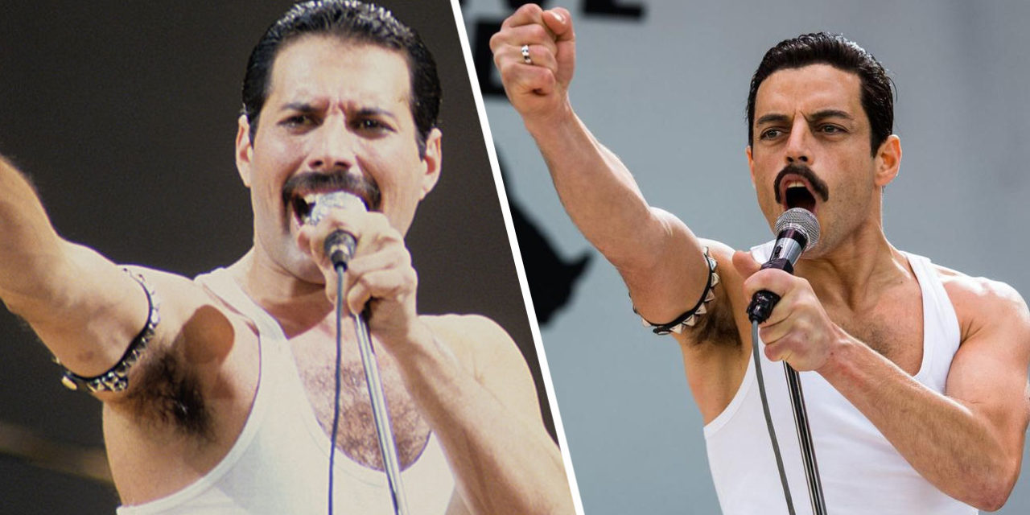
Bohemian Rhapsody (2018)
Biography film of the lead vocalist Freddie Mercury
Oscar Awards: Actor in a Leading Role, Film Editing, Sound Mixing, Sound Editing

Slide 5
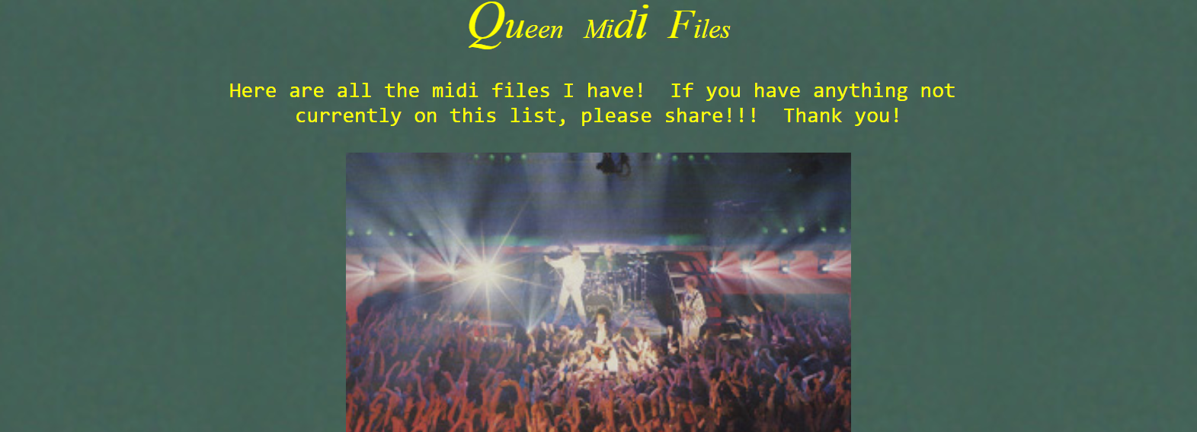
We download data from:
http://tomqueen.tripod.com/midis.html Use 11x Queen’s midi songs as input data

Slide 6
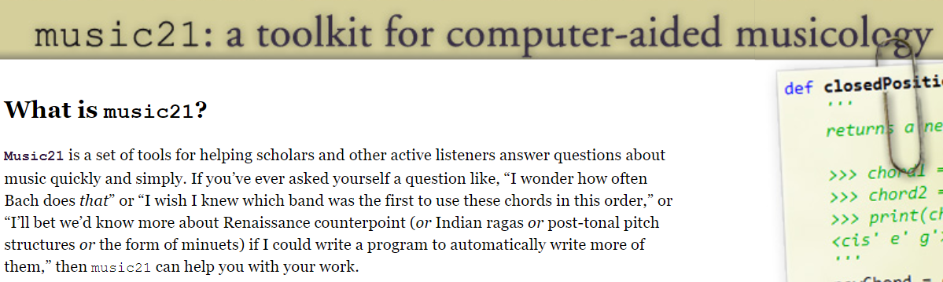
music21
The package we use to handle music data

Slide 7

Our first try…

